Slide 1

M.R. Ashwin Prabhu
Integration MVP
Unified tracking across on premise and the cloud

Slide 2


About Me
Integration MVP for 2016, 2015 & 2014
Independent Consultant in BizTalk Server and Azure
Living in UK
14 Years of experience in BizTalk Server
Blog: http://www.fortuvis.com/blog/
@mrashwinprabhu
https://www.linkedin.com/in/mrashwinprabhu

Slide 3
Overview
Importance of Instrumentation
Expanding scope of integration – On Premise & Cloud
Power BI for BizTalk BAM – On Premise
Power BI for Logic Apps Tracked data - Cloud
Power BI for On Premise & Cloud
Nice to haves
Notes:
In overview of what I am going to talk today

Slide 4

Importance of Instrumentation
BizTalk is NOT a black box
Informed Application is a smart application
Overlooked due to two main reasons:
Considered Secondary development activity. “The instrumentation is an art than an afterthought”
Value proportion under informed
Notes:
How many of you say BizTalk is a black box. If it’s a black box why do we have BizTalk admin console, BizTalk 360, BAM, tracking data, its extensibility nature allowing us to track/trace, log. BIZTALK IS NOT A BLACK BOX. Its us who makes BizTalk solution as a black box without any instrumentation in it.
Why do we need instrumentation? Informed Application is a smart application. Without instrumentation how do you say what happening in your system, how well your system performs, what is the current messaging capacity and how much more your application you can add. This how you let your stakeholder, users, administrator know about what's happening.
How many of you here have received a call from their support team on a Friday evening or on a weekend asking why they not received a file, when its file is not actual been send by the source system. <<SHOW THE CAR BOOT IMAGE>> Its something like getting lock up in your own car boot/trunk in your office car park instead of going home and spend time with your family. No one to blame. Use the arsenal in your armor
Instrumentation has often been overlooked due to two main reasons:
It’s considered as a secondary development activity. The instrumentation is an art than an afterthought. Plan it ahead than afterwards. When you plan new BizTalk infrastructure plan it an create a framework which can be reusable when you roll out project. You can create bespoke instrumentation code for projects.
Sell it. Some features get sold on its own. Like BizTalk360. You don’t need to sell it, just show a demo you will buy it. But some software's/features needs to be unwrapped. Needs to be sold. Show the potential of the instrumentation to your business and support, show the value add it can bring into your operation and also business. Don’t get locked up in the back of your car boot.

Slide 5
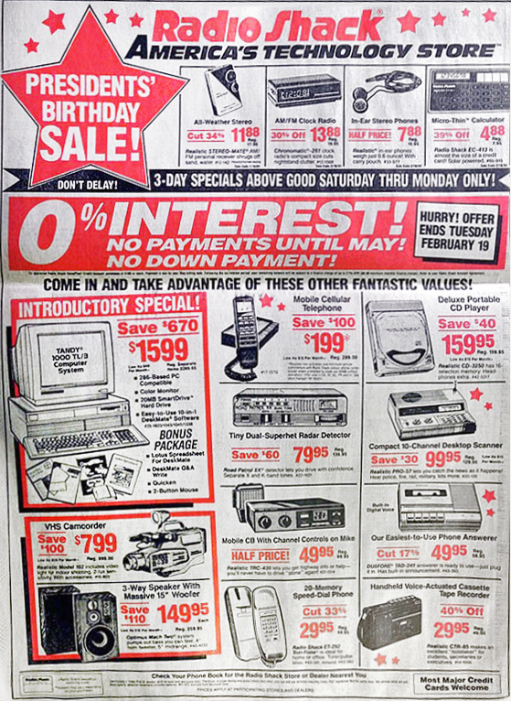
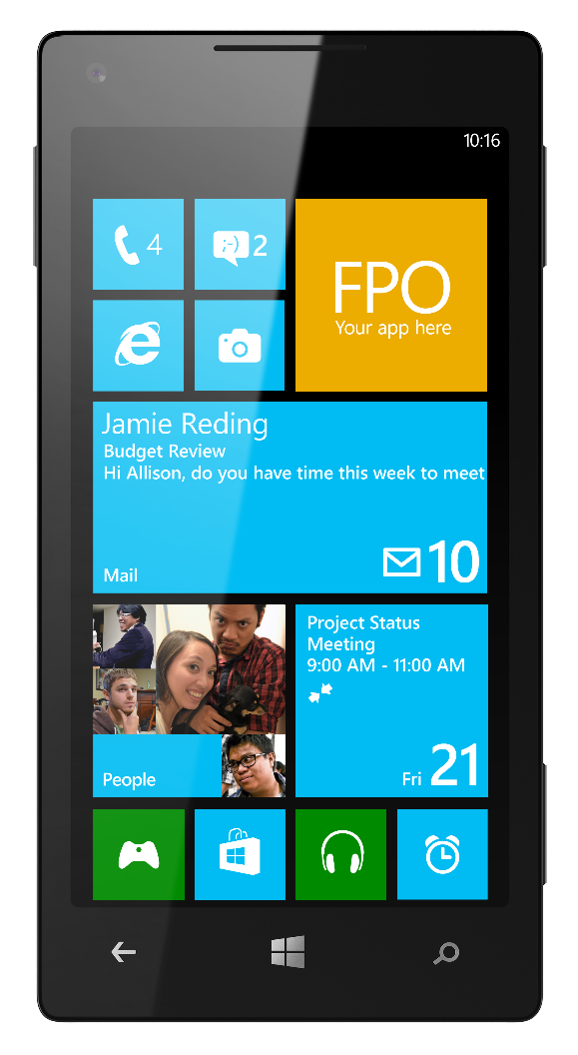
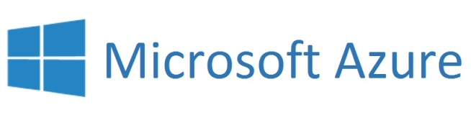
Expanding scope of integration – On Premise & Cloud
Notes:
Integration is not just about connecting different systems sitting in the corner of your on-premise data center. Its about mediating business process between systems. Business process requirements have expanded and grown vertically into the cloud. You may need to integrate with SaaS based systems, you may need to use cloud services for cost & operational effectiveness. Your integration is just using BizTalk anymore but also utilising cloud services.
Have seen this 1991 Radio Shack America’s technology store’s advert going around in social media? 13 out of 15 products are now we have it our pockets. $5000 worth of products are now in $200 mobile phone in terms of mobile applications. Similarly, technologies we use on-premise like racks of servers, on-premise software products, queues, data storage are in more efficient forms in the cloud along with additional offerings. As of now and at least for the near future, it’s going to be utilised of both on-premise and cloud.

Slide 6
Expanding scope of integration – On Premise & Cloud
Notes:
Its my personal opinion, on-premises is something like a home cooked food and Azure is like food from a Michelin star restaurant, but with a cheaper price, high quality food delivered free to your home. But still we would say, mmm let me have my mains from home cooked and sides from Michelin star restaurant or other way around. So as of now its going be a combination of both.
When you have on-premise and cloud based integration platforms, users don’t want to see different tools to view tracked data from different environments. With BizTalk and Logic Apps extensible nature, we can show the instrumented data in one consolidated place. This where Power BI can become one-stop to monitor and analyse, the on-premise and cloud tracked data.

Slide 7
Power BI for BizTalk BAM – On Premise
Notes:
When you have modern day tools like updated BizTalk admin consoles, HTML 5 based flashy BizTalk360 portal with analytics and dashboard. We should still live with the BAM portal built with office web components and Acitve X controls. You can use HTML 5 based Power BI with interactive dashboards.
I am going to show a three quick demos I have developed with very little code. First to show the BAM data in Power BI. Then just the cloud data and finally both the on-premise and could data on one Power BI portal.
First On-premise to Power BI. As of now we can’t connect on-premise SQL server to Power BI –the portal directly, but you do so in Power BI desktop. To see the on-premise SQL server data in portal, the options is use the Power BI desktop to connect with the SQL first, create the reports and then using the Power BI Enterprise gateway you can publish the reports from desktop to the Power BI portal.
<<Show Demo>>
There are two ways to connect to the data store, import or the DirectQuery. Import connection means data will physically be imported into the data model and DirectQuery mean you will retain a live connection to the data source. I preferred DirectQuery option because it always lookd at the live version of the data.
Data transfers between Enterprise gateway and Power BI service through Azure Service Bus. Service Bus creates a secure channel between the gateway and Power BI service. Since the gateway starts the secure connection, there is no need to open a port in your firewall because it’s an outbound connection.

Slide 8
Power BI for Logic Apps Tracked data - Cloud
Notes:
Next is about tracking data from the cloud. Jeff Hollan from Microsoft showed an excellent demo in one of the AzureCon sessions and he also blogged about this.
In Logic apps we will use an Event-hub API to send the tracked events to Azure Event hub and connect Azure Stream Analytics process those tracked events real time and output the data. From Stream Analytics we can route the stream to different outputs. We can directly output to Power BI for real-time analysis, which is to the analysis on the data in motion and another output to table storage for analysis at a longer window – on the data at rest. Table storage is chosen for cheap cost and scalability reasons.

Slide 9
Power BI for On Premise & Cloud
Notes:
And finally, track both the on-premise and cloud data in one place through Azure Event-hubs, input the stream to Azure Stream Analytics from their output the real-time analysis data to Power BI and table storage for analysis at a longer window on data at rest.
For pushing the on-premise data into Event-hubs, you can use a simple helper in custom pipelines or in Orchestration or you can create a custom appender for Log4Net and output the trace into Event Hub. Event Hub is chosen because its meant for high scale scenarios like instrumentation and for being lower cost.
<<Show the demo>>

Slide 10
Nice to haves
BizTalk/BAM content pack for Power BI
More native support to connect on-premise SQL to Power BI
Q&A feature for direct connection from portal
More inbuilt support from Logic App to track the data-rather than to have event-hub API
Azure Diagnostics for Logic App to integrate with Power BI

